Slide 1
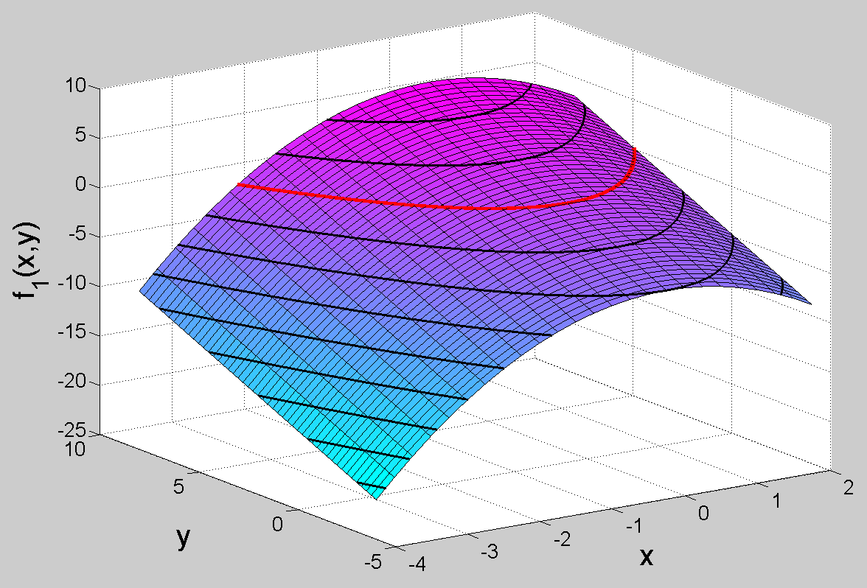
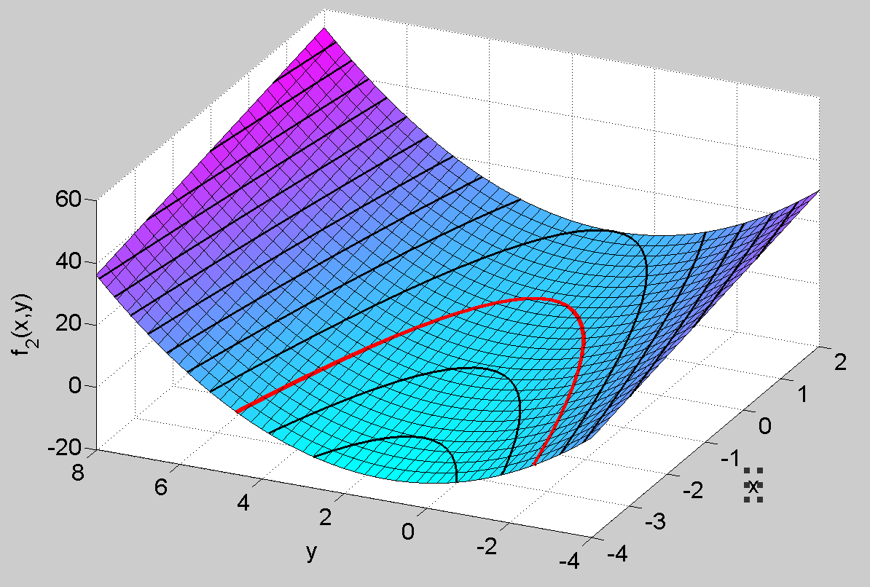
Example Non-Linear System of Equations: Newton’s Method
z=f₁(x,y) = 0
z=f₂(x,y) = 0
Graphical Representation

Slide 2
Example Non-Linear System of Equations: Newton’s Method
Graphical Representation
We will start iteration from the point (0,0),
so we would expect to obtain the intersection
point on the right.

Slide 3
Example Non-Linear System of Equations: Newton’s Method
The Non-Linear System:
Newton’s Method in matrix form (from your class notes):
Starting point: (x_{0,} y₀) = (0, 0)
-
Keep Plugging back
into Matrix equation
You can solve this system any way you want: Gauss Elimination, LU-decomp. Or by using J ⁻¹

Slide 4
Example Non-Linear System of Equations: Newton’s Method
Calculating the
After the first iteration…
Calculating the
After the second iteration…
Keep going…until
a given tolerance.

